Slide 1
TOURIST ATTRACTIONS OF OUR REGION LITHUANIA Cultural Reserve of Kernavė

Slide 2
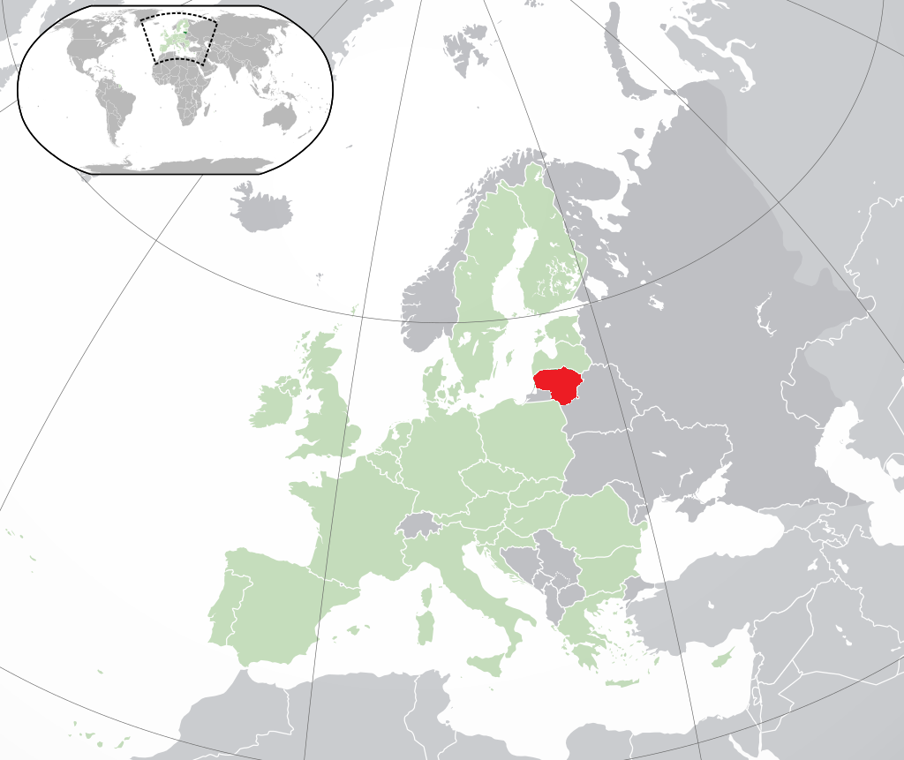
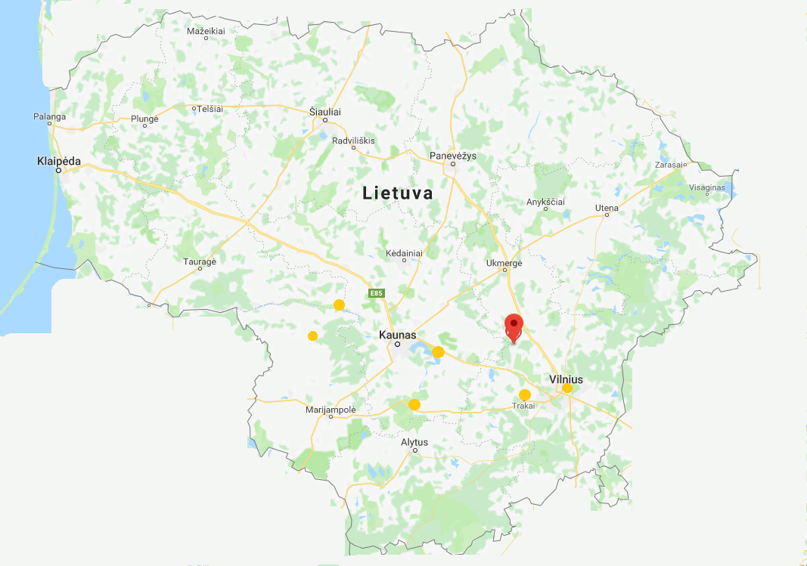
Dzūkija Kernavė Hillforts
LOCATION
Map of the country
Map of the area with other sites

Slide 3
Dzūkija Kernavė Hillforts
TYPE OF SITE
It’s a naturalistic site, that contains five hillforts.
PHYSICAL AND AESTHETIC FEATURES
On the top of the hillforts you can see an amazing view of the horizon and the river Neris.
AREA COVERED
It covers 1755 m².
HISTORICAL/SCIENTIFIC/ARTISTIC INFORMATION
Kernavė was a medieval capital of the Grand Duchy of Lithuania. The hillforts were used for building watchtowers and altars.
DATING
Been used in IX thousand years BC till the XVI century.
Investigated 1979-2007

Slide 4
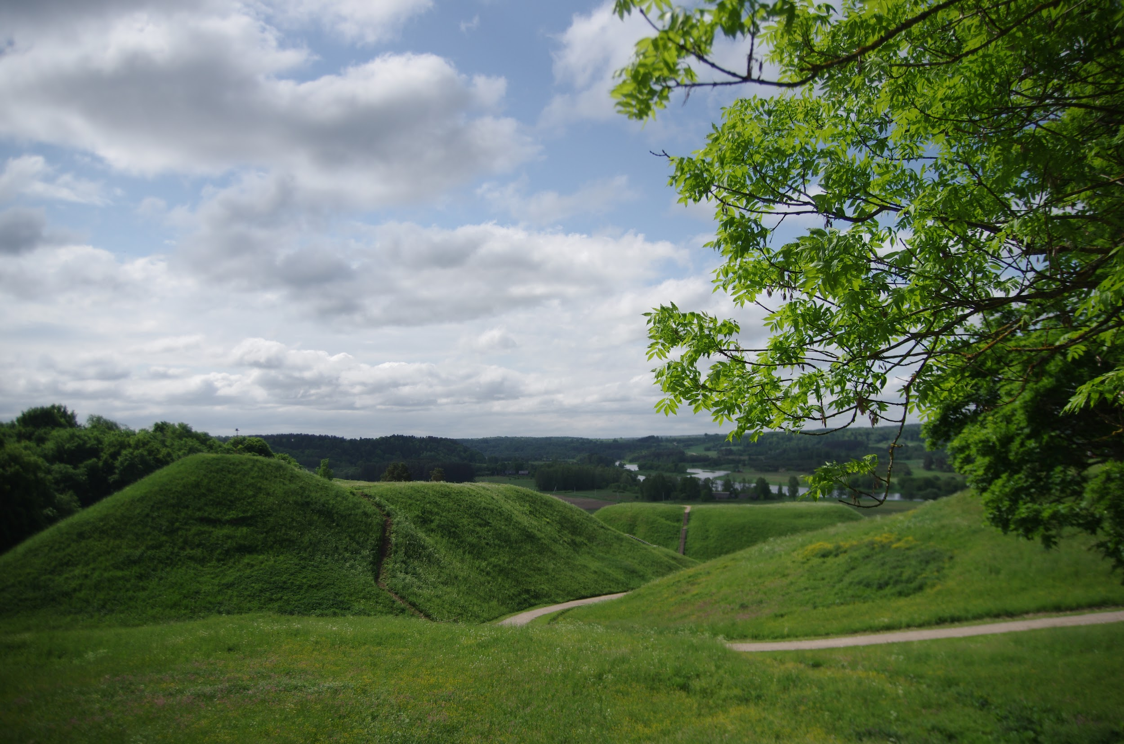
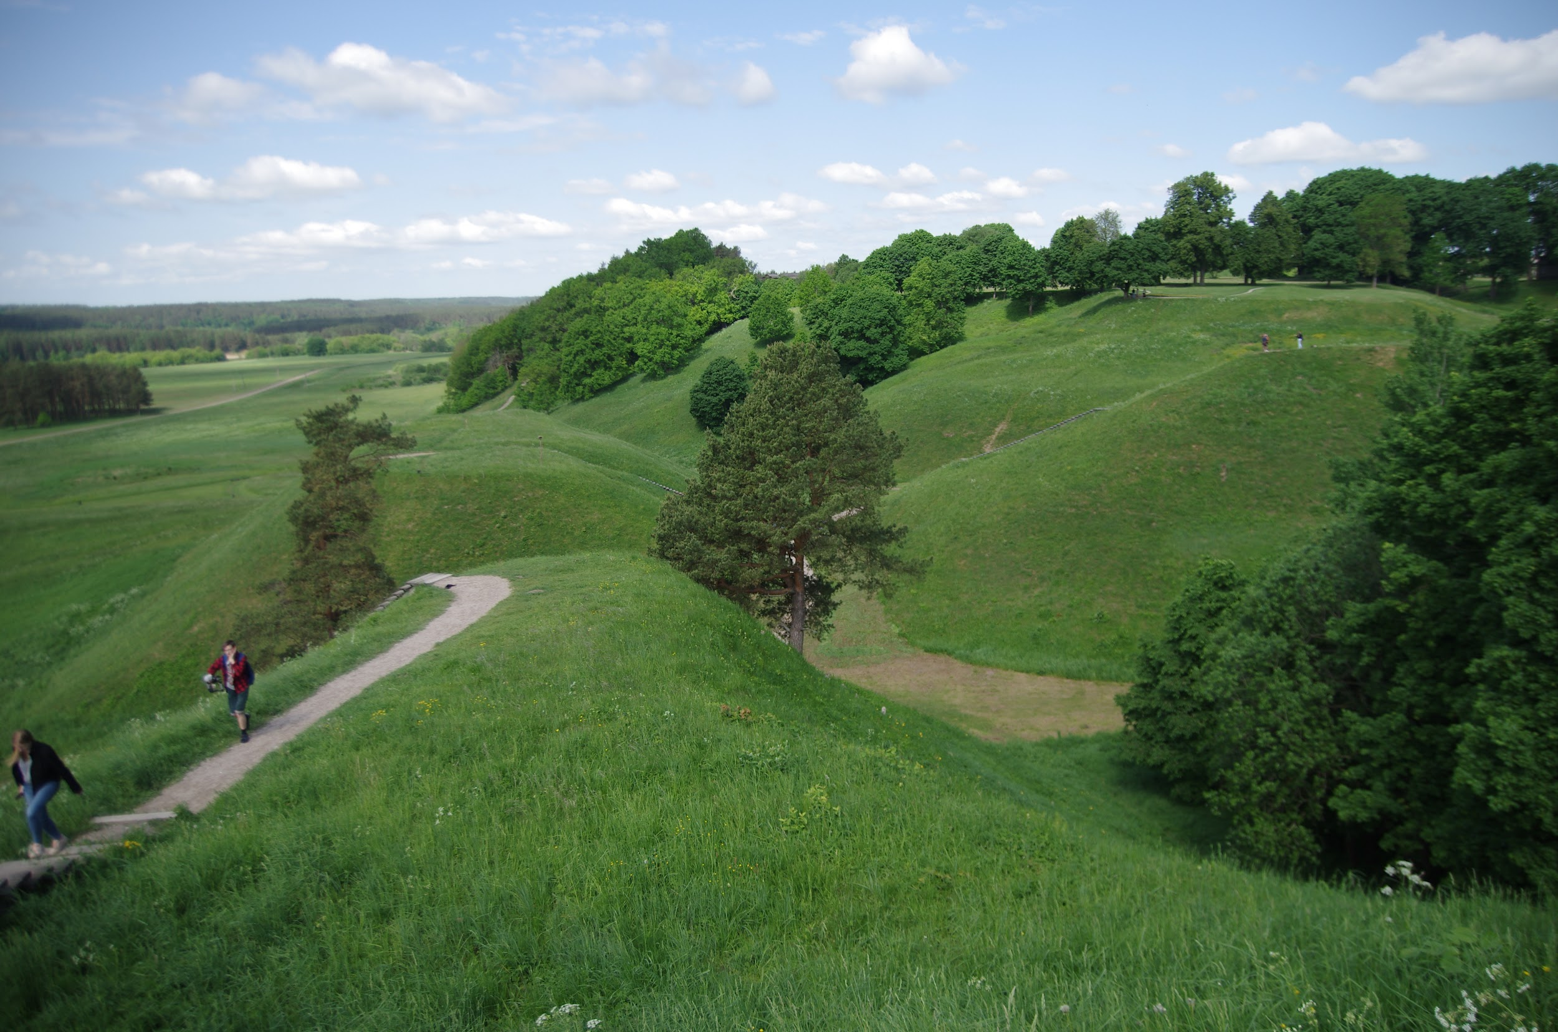
Dzūkija Kernavė Hillforts
HIGHLIGHTS
Kernavė hillforts from Kernavė town
On the top of the Altar’s hill

Slide 5
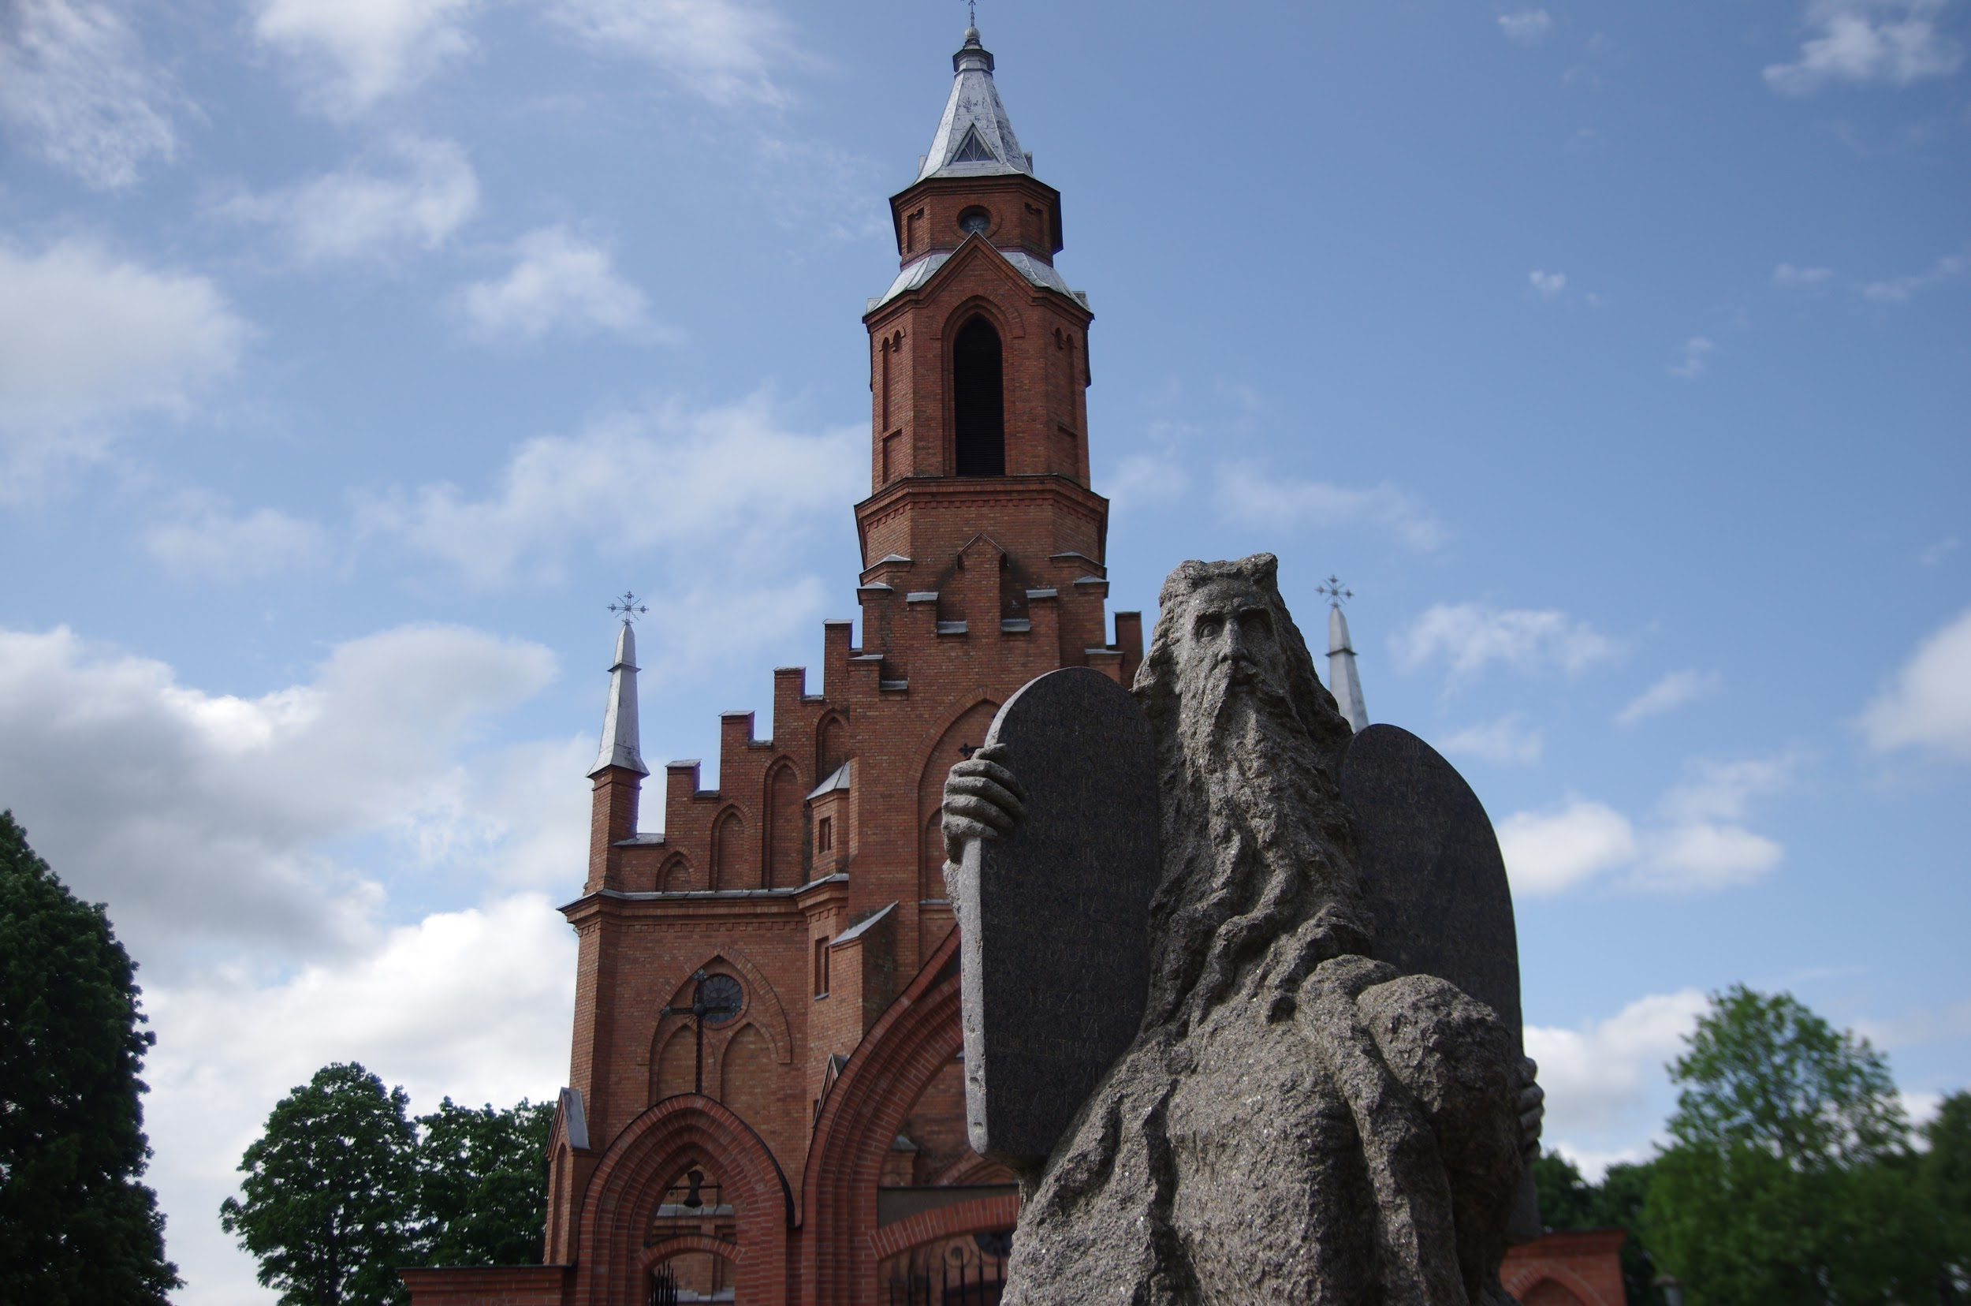
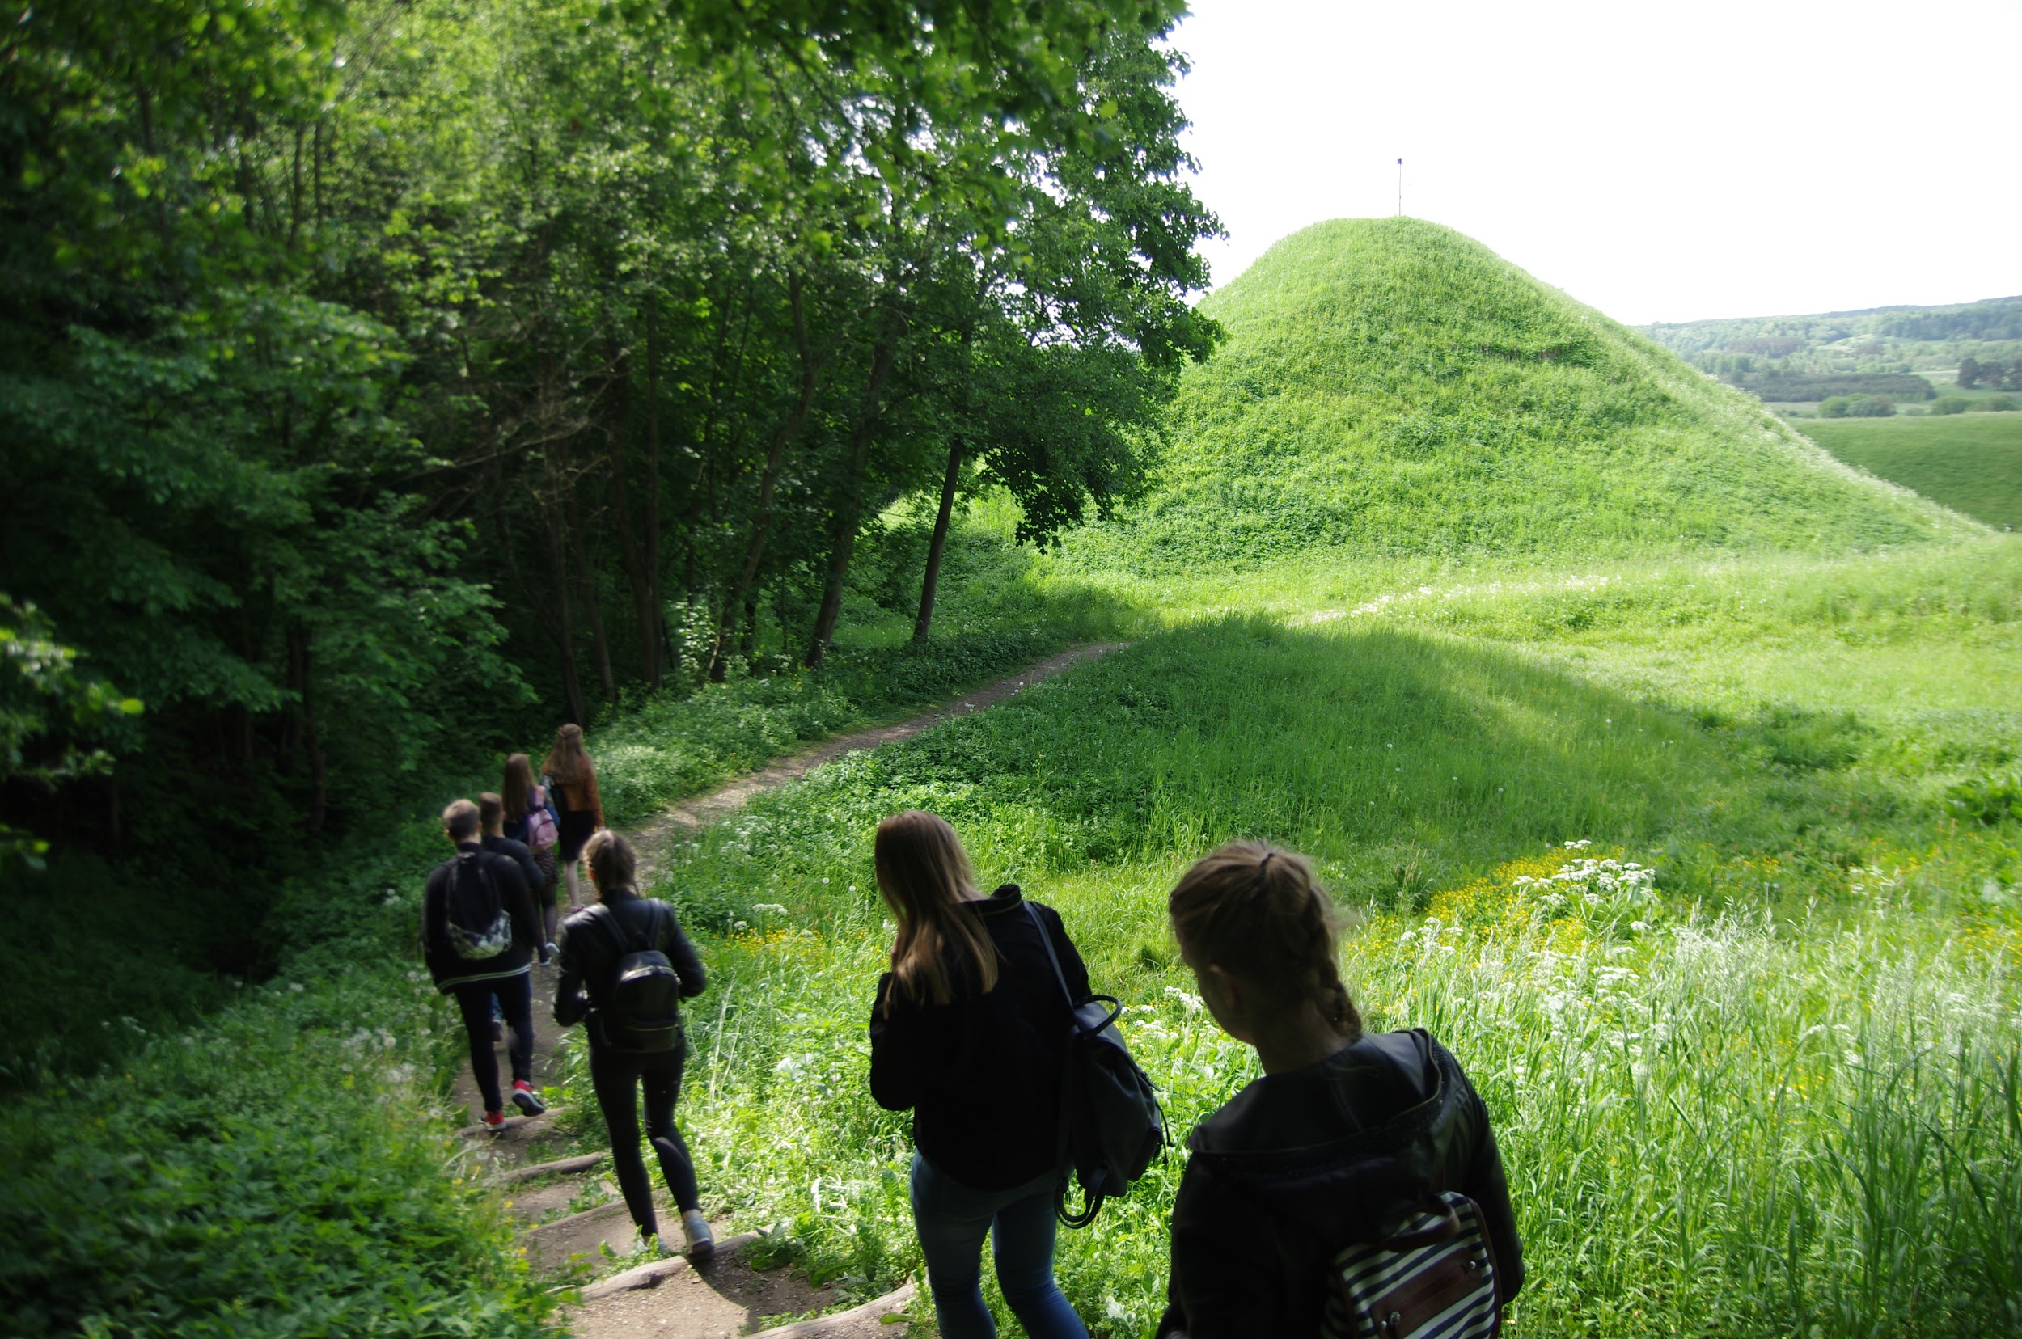
Dzūkija Kernavė Hillforts
CONDITION OF PRESERVATION
Everything is clean and easy to reach every hill.
VISITING TIME
On Monday and Tuesday it is closed. From Wednesday to Sunday it is opened from 10 to 18. Also in this sanctuary you can see a few chapels and hillforts.
LEGAL OWNERSHIP
Kernavė hillforts are owned by Kernavė national and cultural sanctuary and it is secured by UNESCO.
TICKETS AND BOOKING
It is free.

Slide 6
Dzūkija Kernavė Hillforts
ACCESSIBILITY
There is no accessibility for disabled people, because there are stairs. You can reach Kernavė by bus or your transport.
FACILITIES
Kernavė is a small town, where you can find a few shops, 3 guest houses and a lot of farmsteads around river Neris and lake Kernavė.

